Slide 1
Cancer Patient In UAE Data Analysis Project
•🔬 InternPulse Group 5 | 📅 May 2025
Ogochukwu Nneka Uchenwoke
Seunfunmi Rachel Adegboyega
Nse Stephen Anyameluhor

Slide 2
Project Objective
•- Build ML models using UAE cancer patient data
•- Goals:
• • Classify cancer stages
• • Identify hidden clusters for treatment insights
• • Support early diagnosis through data patterns
Research Framework
•Three Key Pillars:
•1. EDA – Understand trends & recovery rates
•2. Predictive Modeling – Classify cancer stages
•3. Clustering Analysis – Discover patient subgroups

Slide 3
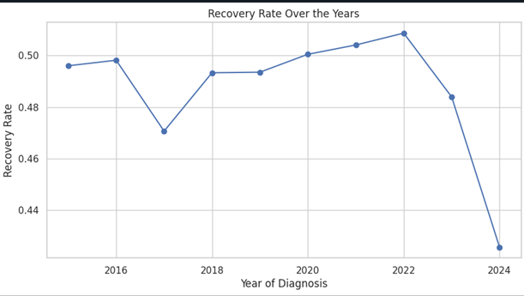
Exploratory Data Analysis (EDA)
Recovery rate trends over multiple years

Slide 4
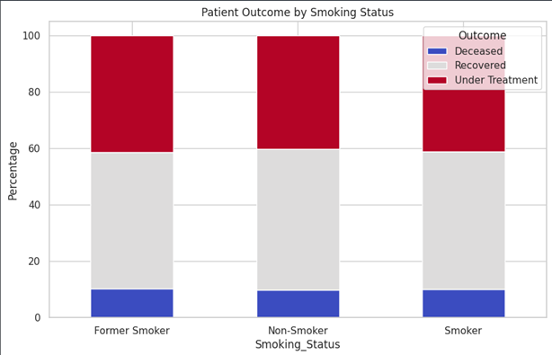
Exploratory Data Analysis (EDA)
Smoking impact on outcomes

Slide 5
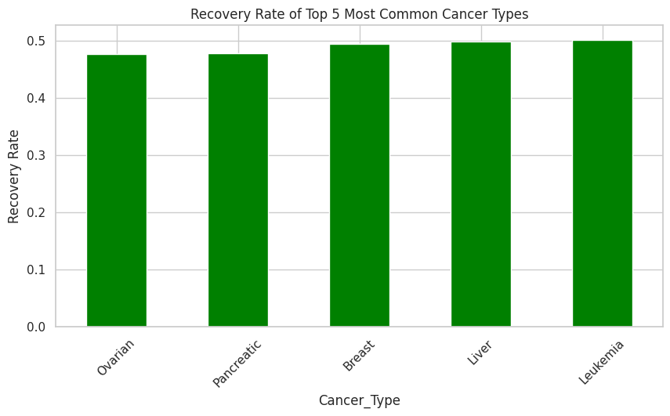
Exploratory Data Analysis (EDA)
Most common cancer types (Top 5)

Slide 6
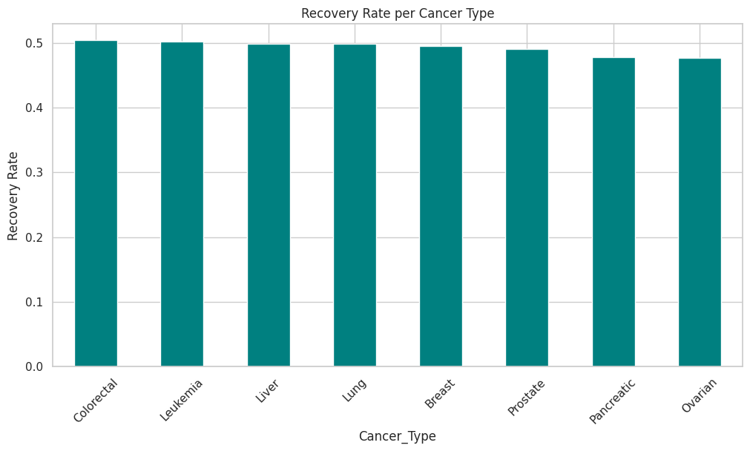
Exploratory Data Analysis (EDA)
Recovery patterns by cancer type

Slide 7
Predictive Modeling Setup
•Target Variable: Cancer Stage (I–IV)
•Features Used:
•- Demographics: Age, Gender, Nationality, Ethnicity
•- Lifestyle: Smoking
•- Medical: Type, Weight, Height
•Approach:
•- Baseline: Random Forest
•- Improved: XGBoost
•- Handled imbalance: SMOTE
Model Performance
•Model Performance Summary:
•- Random Forest: 32% Accuracy, 7% Stage IV Recall (Best balance)
•- XGBoost: 28% Accuracy, 6% Stage IV Recall
•- XGBoost + SMOTE: 26% Accuracy, 8% Stage IV Recall

Slide 8
Clustering Analysis
•Goal: Find patient subgroups without labels
•Method:
•- KMeans (4 clusters)
•- PCA for 2D visualization
•Features Used:
•- Age, Gender, Nationality, Ethnicity, Smoking, Cancer Type, Weight, Height
•Cluster Insights:
•- Cluster 0: Mostly male, non-smokers
•- Cluster 1: Majority female, highest smoking rate
•- Cluster 2: Mixed gender, mostly foreign nationals
•- Cluster 3: Entirely female, all local nationality

Slide 9
Tools & Deliverables
•Languages/Libraries:
•- Python, pandas, numpy, seaborn, scikit-learn
•- XGBoost, imbalanced-learn (SMOTE), PCA
•Deliverables:
•- EDA0.ipynb, cancer_modeling.ipynb
•- Cluster visualizations
•- GitHub repo

Slide 10
Findings, Summaries & Recommendations
🔍 Findings
Exploratory analysis revealed that recovery rates vary by year, cancer type, and smoking status, with smokers experiencing notably lower recovery. Predictive models struggled to accurately classify late-stage cancer, with the best model achieving only 32% accuracy. Clustering uncovered four distinct patient groups characterized by gender, smoking habits, and nationality, suggesting diverse treatment needs.
🧾 Summary
This machine learning project aimed to support early diagnosis, stage classification, and treatment personalization for cancer patients in the UAE. Through EDA, we discovered key trends in recovery based on demographics and lifestyle. Predictive modeling revealed the difficulty in classifying late-stage cancer due to class imbalance and feature limitations. Clustering uncovered distinct patient subgroups that could benefit from tailored care approaches.
✅ Recommendations
To improve outcomes, healthcare providers should prioritize early screening and develop targeted smoking cessation initiatives for high-risk groups. More balanced datasets and additional medical features are needed to enhance model performance and reliability. Policymakers should use patient clusters to guide personalized treatment plans and public health outreach.

Slide 11
Thank you!

